Slide 1


VA Solid Start –
Code Walkthrough
Microsoft confidential. For internal use only.

Slide 2

Source Code
Workflows
Custom Activities
Import Workflows
Business Logic Workflows
Web Resources
Outbound Call
Enrollment and Eligibility
Take ownership and Reassignment
GetVeteranUpdate and GetAddress
Plugins
Reassignment
Agenda

Slide 3
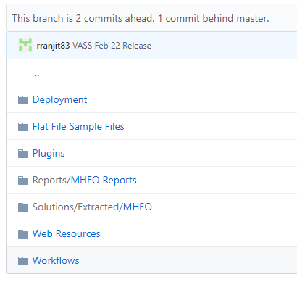
Source Code
Location: VA Git hub: https://github.com/department-of-veterans-affairs/crm-udo-code
Folder Name: UDO.VASS

Slide 4

Questions

Slide 5
© 2015 Microsoft Corporation. All rights reserved. Microsoft, Windows, Windows Vista and other product names are or may be registered trademarks and / or trademarks in the U.S. and / or other countries. The information herein is for informational purposes only and represents the current view of Microsoft Corporation as of the date of this presentation. Because Microsoft must respond to changing market conditions, it should not be interpreted to be a commitment on the part of Microsoft, and Microsoft cannot guarantee the accuracy of any information provided after the date of this presentation. MICROSOFT MAKES NO WARRANTIES, EXPRESS, IMPLIED OR STATUTORY, AS TO THE INFORMATION IN THIS PRESENTATION

